Slide 1
Operation analytics & investigating metric spike
ADVANCED SQL
Submitted by : Sruthi Suresh

Slide 2
CONTENTS
PROJECT DESCRIPTION
APPROACH
TECH-STACK USED
CASE STUDY 1 : JOB DATA ANALYSIS
TASK A: JOBS REVIEWED OVER TIME
TASK B: THROUGHPUT ANALYSIS
TASK C: LANGUAGE SHARE ANALYSIS
TASK D: DUPLICATE ROWS DETECTION
CASE STUDY 2 : INVESTIGATING METRIC SPIKE
TASK A: WEEKLY USER ENGAGEMENT
TASK B: USER GROWTH ANALYSIS
TASK C: WEEKLY RETENTION ANALYSIS
TASK D: WEEKLY ENGAGEMENT PER DEVICE
TASK E: EMAIL ENGAGEMENT ANALYSIS
CONCLUSION

Slide 3
PROJECT DESCRIPTION: Operation analytics & investigating metric spike
Operational Analytics is a crucial process that involves analyzing company’s end-to-end operations. The key aspect of Operational Analytics is investigating metric spikes which involves understanding and explaining sudden changes in key metrics, such as a dip in daily user engagement or drop in sales.
As a Lead data Analyst at a company like Microsoft, this project helps in utilizing advanced SQL skills to analyze the data and provide valuable insights that can help in improving the company’s operations and understand sudden changes in key metrics.

Slide 4

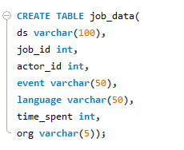
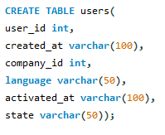

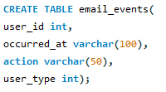
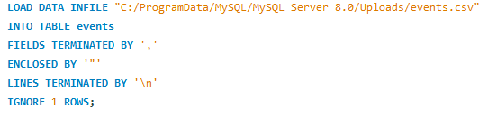
APPROACH:
Create Database.
Create Tables for Case study 1 and Case study 2.
Load the data from csv files to the MySQL Workbench.
For e.g., for the table events load file using the below queries. Similarly for other tables also.

Slide 5
APPROACH:
Understand the structure of the tables along with the datatypes of each column present in the tables: job_data, users, events, email_events.
SQL queries are used to manipulate and perform the analysis : Operation analytics and investigating metric spike which will help in extracting meaningful insights from the data.

Slide 6


Tech-stack used:
MySQL Workbench 8.0 CE
Excel
The SQL file Link
Operation analytics and Investigating Metric Spike.sql

Slide 7
CASE STUDY 1 : JOB DATA ANALYSIS
Jobs Reviewed Over Time
To calculate the number of jobs reviewed per hour for each day in November 2020.
Throughput Analysis
To calculate the 7-day rolling average of throughput. Additionally, explain whether you prefer using the daily metric or the 7-day rolling average for throughput, and why.
Language Share Analysis
To calculate the percentage share of each language over the last 30 days
Duplicate Rows Detection
To display duplicate rows from the job_data table.

Slide 8
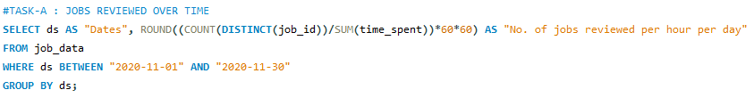
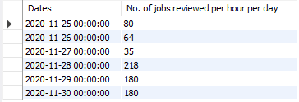
TASK A: JOBS REVIEWED OVER TIME
SQL Query:
Result:
Insights:
The number of jobs reviewed per hour per day is maximum on 28th November 2020 which is 218 followed by 29th and 30th of November 2020 which is 180.
The number of jobs reviewed per hour per day is minimum on 27th November 2020 which is 35.

Slide 9
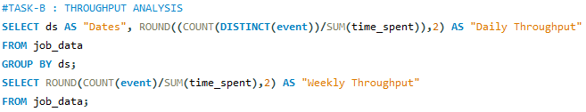
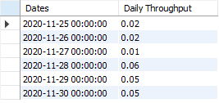

TASK B: THROUGHPUT ANALYSIS
SQL Query:
Result:
Insights:
The throughput analysis were analyzed daily and the highest throughput was found to be 0.06 on 28th November 2020 and lowest throughput was found to be 0.01 on 27th November 2020.
The weekly throughput analysis were also done and is found to be 0.03.
Generally, Rolling average for throughput = sum of data over time / time period. To discover the trends in data, using smaller parts of the data is preferred. Considering the above data, daily metric gives a better understanding of trends going up or down. However, there are chances of incorrect insights drawn because of daily fluctuations.

Slide 10

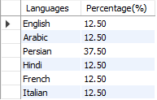
TASK C: LANGUAGE SHARE ANALYSIS
SQL Query:
Result:
Insights:
Over the last 30 days, the highest percentage share was for the Persian Language which accounts to 37.50% and the remaining languages English, Arabic, Hindi, French and Italian have a share of 12.50% each.

Slide 11
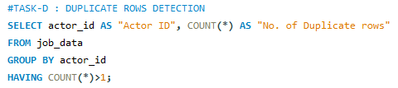



TASK D: DUPLICATE ROWS DETECTION
SQL Query:
Result:
Insights:
While considering the actor_id column, there are 2 records corresponding to actor_id 1003.
While considering the job_id column, there are 3 records having the same job_id as 23.

Slide 12
CASE STUDY 2 : Investigating Metric Spike
Weekly User Engagement
To calculate the activeness of users on a weekly basis.
User Growth Analysis
To calculate the user growth for the product.
Weekly Retention Analysis
To calculate the weekly retention of users based on their sign-up cohort.
Weekly Engagement Per Device
To calculate the weekly engagement or activeness of users per device.
Email Engagement Analysis
To understand how users are engaging with the email service.

Slide 13
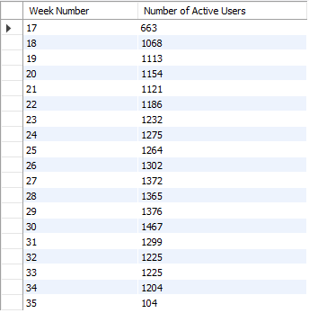
TASK A: WEEKLY USER ENGAGEMENT
SQL Query:
Result:
Insights:
Weekly User Engagement metrics measures the number of unique users who engage with a product/app/service within a 7-day period.
The highest number of active users were in the 30th week of November and least user engagement was in the 35th week of November.

Slide 14
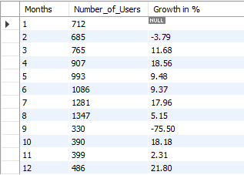
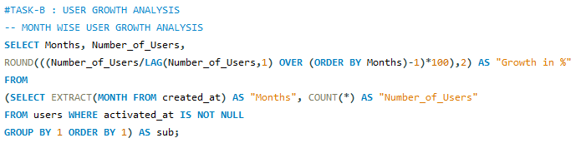
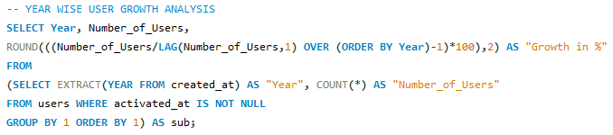

TASK B: USER GROWTH ANALYSIS
SQL Query:
Result:
SQL Query:
Result:
Insights:
There is a significant 85.74 % growth in the number of users in the year 2014 than 2013.
The number of users have declined in the month of September signifying a dip of 75.50%.

Slide 15
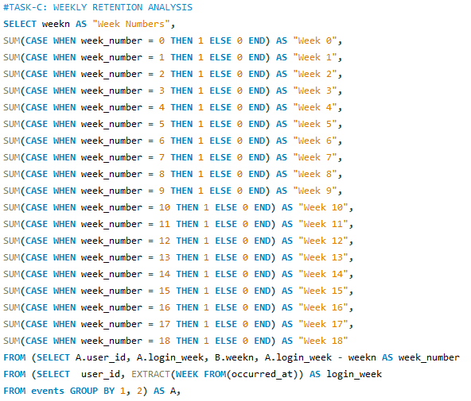
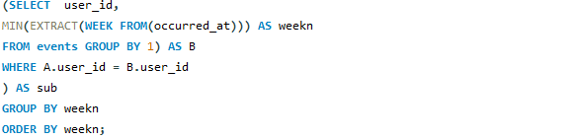
TASK C: WEEKLY RETENTION ANALYSIS
SQL Query:

Slide 16
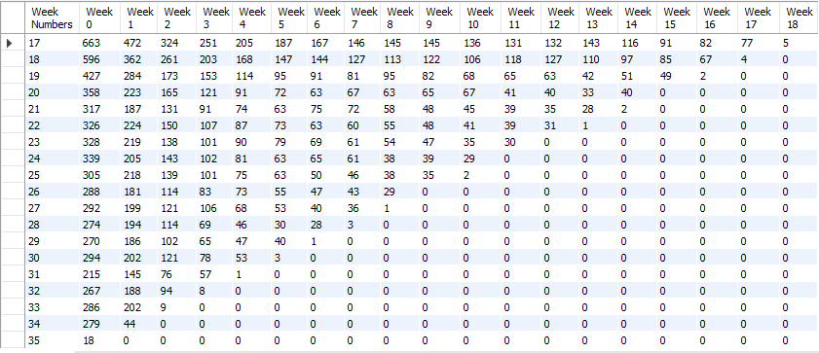
TASK C: WEEKLY RETENTION ANALYSIS
Result:
Insights:
There is a decline in the Weekly user retention over the time. More focus needed to improve strategies and enhance user experience.

Slide 17
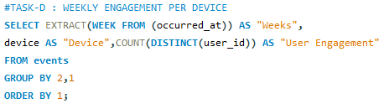
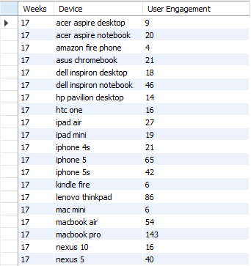
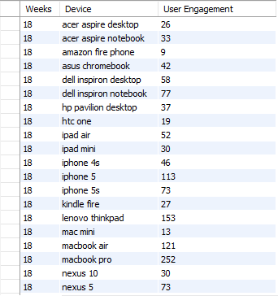
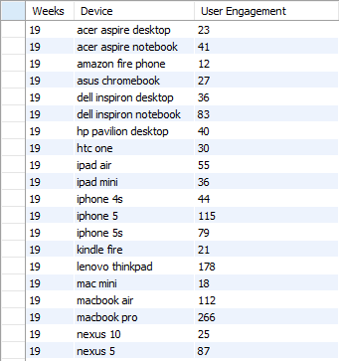
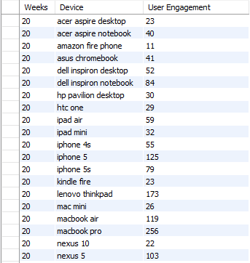
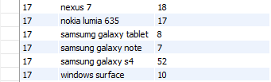
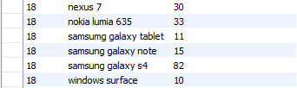
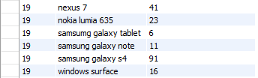
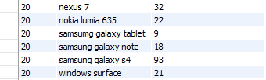
TASK D: WEEKLY ENGAGEMENT PER DEVICE
SQL Query:
Insights:
Weekly Engagement varies across devices and weeks. Adaptive strategies is needed to monitor device trends and optimize user engagement for lower engagement devices.
Result:

Slide 18
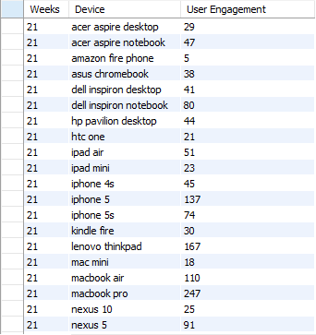
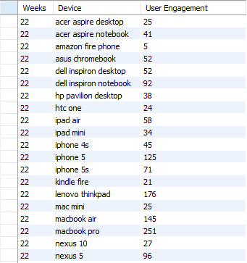
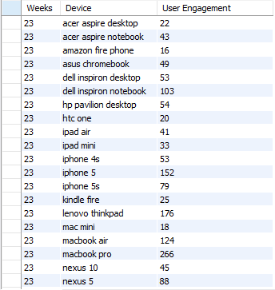
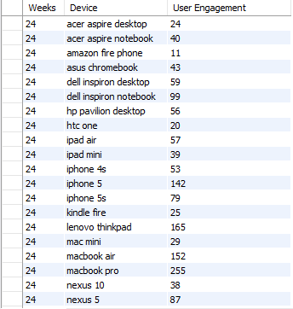

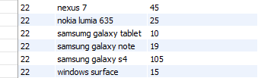
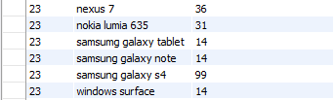
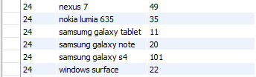

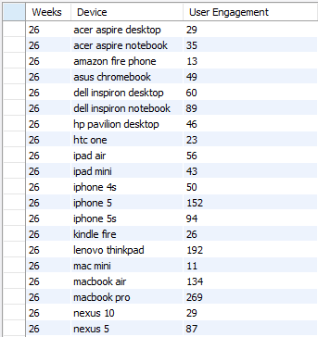
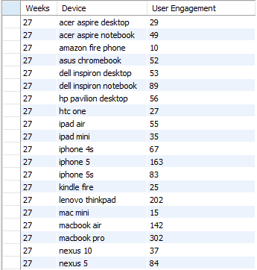
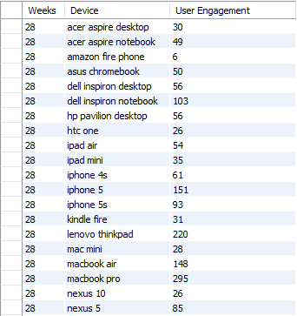
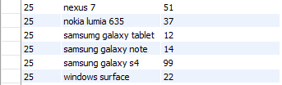
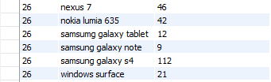
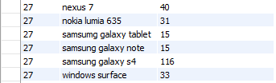
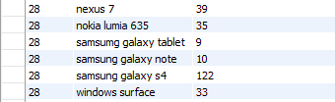

Slide 19
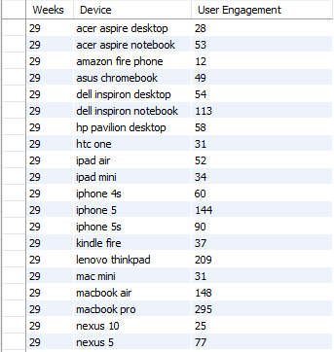
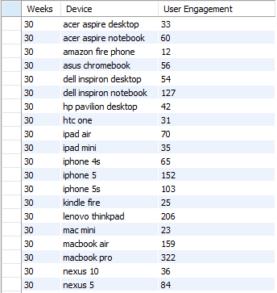

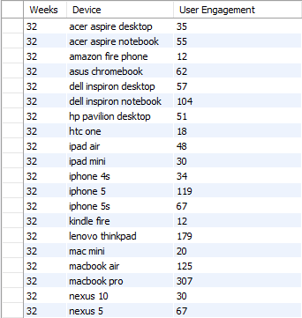
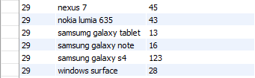
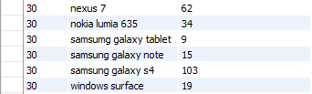
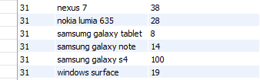

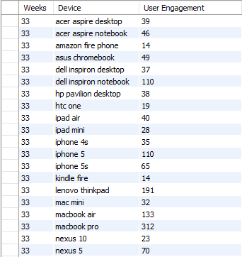
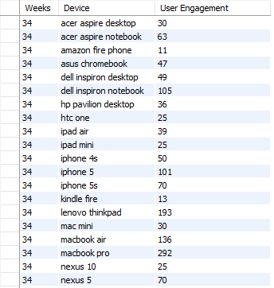
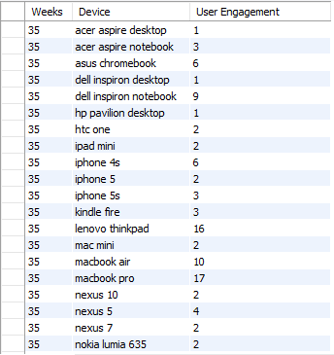
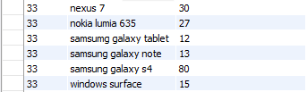



Slide 20


TASK E: EMAIL ENGAGEMENT ANALYSIS
Insights:
SQL Query:
The company has to compare the results with the industry set benchmarks and focus on optimizing the emails to improve the user engagement.
Result:

Slide 21
Conclusion
This project helps in understanding how Data Analytics play a great role in analyzing a company’s end-to-end operations while working with various teams, such as operations, support, and marketing, helping them derive valuable insights from the data they collect. This analysis also pave way for investigating metrics and to know how to deal with these metric spikes.
Doing this project, helped in learning Advanced SQL concepts to get the desired output and to load huge amount of data present in csv files using MySQL workbench.

Slide 22
THANK YOU

